Slide 1
AI-Driven Hyper-Personalization & Recommendations
Team – SmartReconcilers
Pavani Kondru
Priyadharsini A
Harini Vetrivelan
Anjali Puthillath

Slide 2
Overview
Problem Statement
Our Approach & Key Features
Model Selection
Design Overview
Detail Design & Tech Stack
Tests
Model Efficiency
Challenges Faced

Slide 3
Problem Statement
Modern customers expect highly personalized experiences that cater to their unique preferences
Design and Develop a Gen-AI driven solution that enhances the hyper personalization by analysing customer profiles, social media activity, purchase history, sentiment data and demographic details.
The system should generate personalized recommendations for products, services or content while also providing actionable insights for business to optimize customer engagement.

Slide 4
Our Approach & Key Features
Our approach to the problem statement is to consider bank customers, who will be availing one or more of the bank products and how we can personalize their experience and provide recommendations which optimizes their engagement.
Categorize based on users transaction history and provide recommendations using AI
Alert notification based on transaction limit
Provide product recommendation to the user using user based collaborative filtering
Provide recommendation based on social media data for the user
A chat bot which provided recommendations based on key in text or uploaded voice message
Investment Strategy using market trends

Slide 5
Model Selection
GPT-2 (gpt2)
Preloaded for potential text generation.
Could be used for AI-driven chatbot responses, though not explicitly used.
spaCy (en_core_web_sm)
NLP-based keyword extraction.
Helps extract relevant financial terms from tweets.
Hugging Face Transformers (pipeline("sentiment-analysis"))
Sentiment classification of tweets.
Determines if a user’s tweet is positive or negative, influencing product recommendations.
LightFM
Collaborative filtering for personalized product recommendations.
Trains on user interactions to suggest relevant financial products.
Sentence-Transformers (all-MiniLM-L6-v2)
Embedding-based search for chat recommendations.
Helps find relevant financial suggestions based on user input.
FAISS
Efficient similarity search for recommendation queries.
Speeds up AI-powered customer support.
VADER (SentimentIntensityAnalyzer)
Sentiment scoring for chatbot input.
Provides an additional measure of user sentiment.
DistilBERT (distilbert-base-uncased)
AI-based transaction categorization.
Automatically classifies user transactions into categories like groceries, entertainment, and utilities.
Tensorflow Recommenders

Slide 6
Design Overview
UI
Flask Web App
DB
Aggregator
Chatbot
Product Recommender
Personalized Recommender
Transaction Categorization & Notification
Investment Strategy Recommender

Slide 7
Detail Design & Tech Stack
Flask-based web application with functionalities for financial transaction management, sentiment analysis, AI-driven recommendations, and user interaction handling. Key functionalities include:
User Authentication: Login and session management.
Database Operations: Fetching user data, transactions, savings, and loan details from DB.
Sentiment Analysis: Extracting sentiments from tweets and using them for financial product recommendations.
AI-Powered Recommendations:
Personalized product recommendations based on tweets (using LightFM).
Chat-based recommendations using Sentence-BERT and FAISS.
Transaction categorization using DistilBERT.
Financial Alerts & Strategy: Notifications based on savings goals, transaction limits, and loan repayments.
Visualization: Transaction category pie chart with Plotly.
Tech Stack:
Python
Flask
SqlLiteDB
HTML
Docker

Slide 8
Model Efficiency
Model | Purpose | Efficiency Factors | Expected Performance
GPT-2 (Hugging Face) | Text Generation | Slow on CPU, faster with GPU, large memory usage | Moderate to slow
spaCy (en_core_web_sm) | NLP (Keyword Extraction) | Lightweight, optimized for CPU | Fast
Hugging Face Sentiment Analysis (pipeline("sentiment-analysis")) | Sentiment Analysis | Optimized for transformers, medium computational load | Fast (~30ms per sentence on GPU)
LightFM | Collaborative Filtering (Recommendations) | Sparse matrix computation, efficient for large datasets | Fast with sparse data
Sentence-Transformers (all-MiniLM-L6-v2) | Text Embedding for Recommendations | Compact model, optimized for inference speed | Moderate (~10ms per query on GPU)
FAISS | Vector Search for Similarity Matching | Highly efficient, optimized for large-scale retrieval | Very fast (~1ms for 1M embeddings)
VADER Sentiment Analyzer | Rule-based Sentiment Analysis | Lightweight, CPU-efficient | Very fast (~1ms per sentence)
DistilBERT (distilbert-base-uncased) | Transaction Categorization | Smaller BERT model, 60% faster than BERT | Moderate (~40-50ms per transaction on GPU)

Slide 9
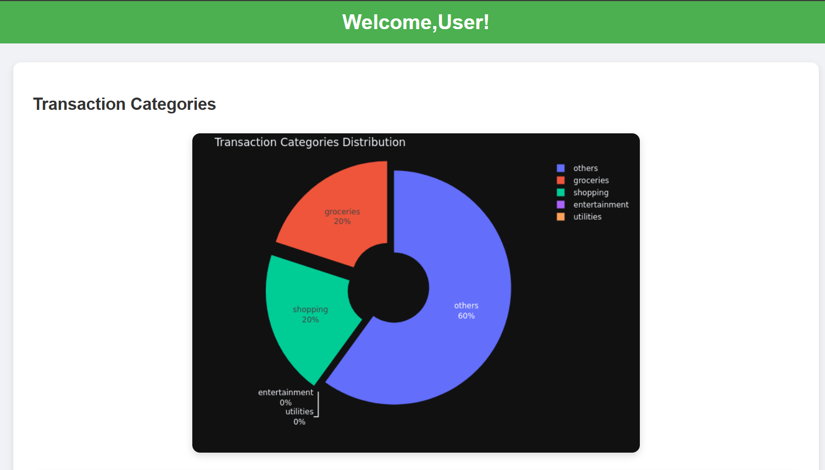
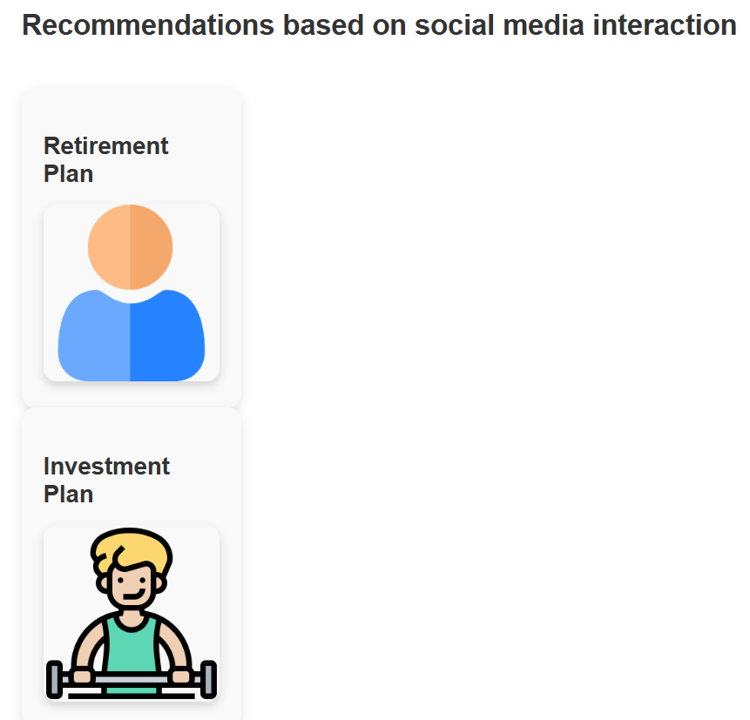

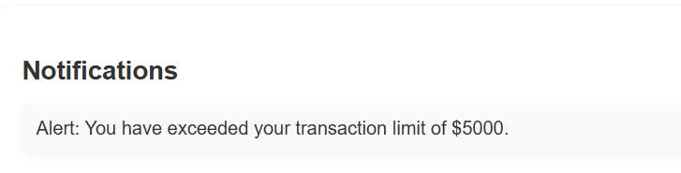
Tests

Slide 10
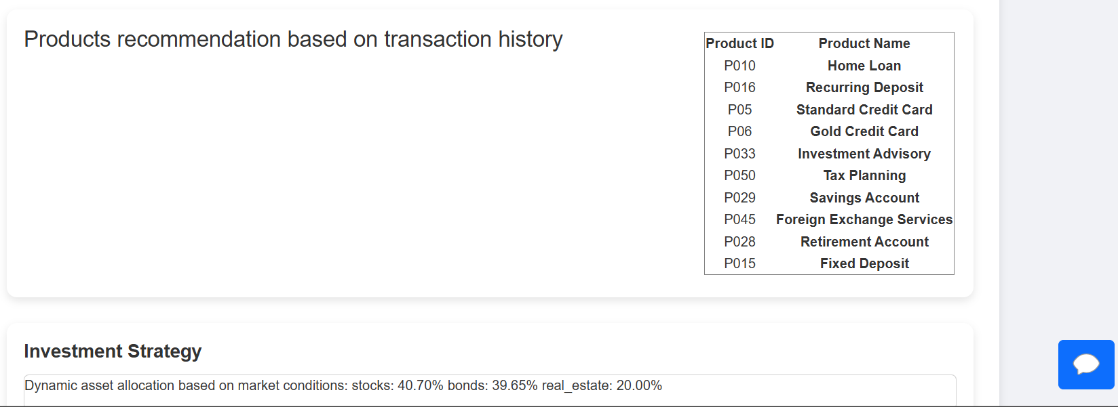
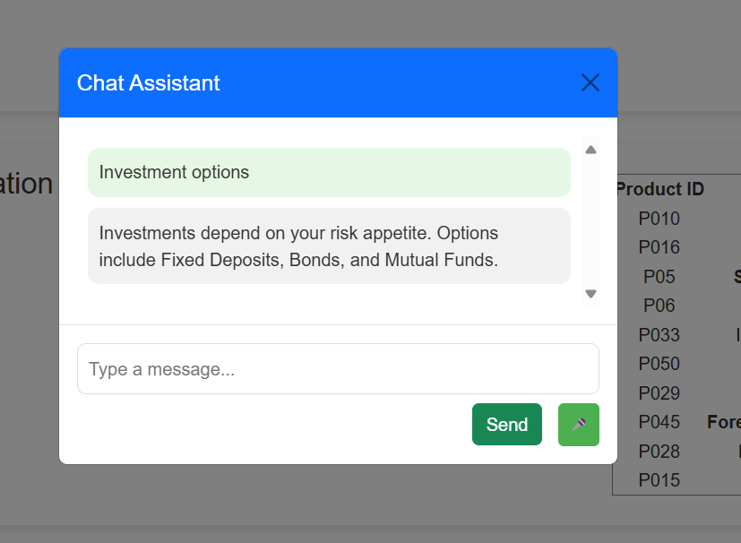

Slide 11
Challenges Faced
Open AI provided relevant recommendations but its services can be availed only through paid subscription
Dependency resolution for different models while creating docker image

Slide 12
Thank You

